Slide 1
DNI FMLT: MAMU Mandatory Amendments
North Island Central Coast Resource District
April 20th, 2022

Slide 2
MAMU Order / Notice
December 2, 2021
FSP Amendment Submission Due
June 2, 2022

Slide 3
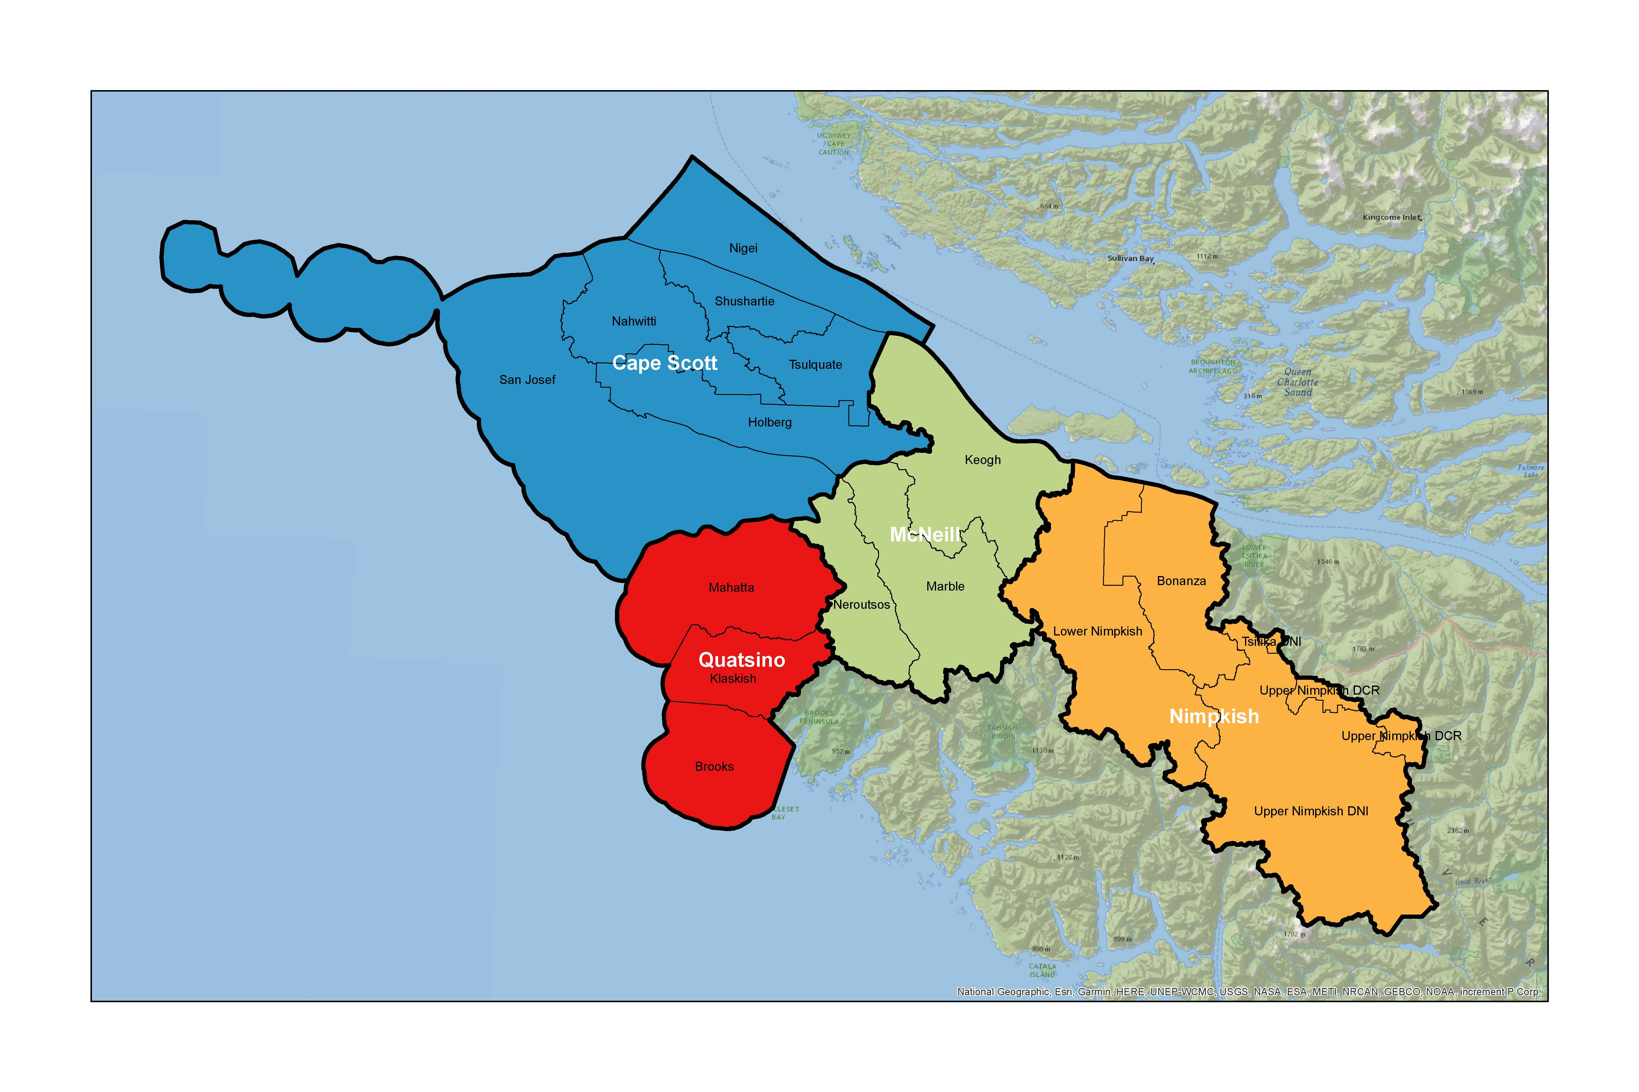
Marbled Murrelet Land Use Aggregates and Portions in DNI
DNI is in the West & North Vancouver Island MAMU Conservation Region. DNI is covered by 4 Landscape Unit Aggregates. Each LU Aggregate is divided into several LU Portions.
Notes:
DNI is in the West & North Vancouver Island MAMU Conservation Region. DNI is covered by 4 Landscape Unit Aggregates. Each LU Aggregate is divided into several LU Portions.

Slide 4
FSP MAMU Amendment RESULTS and STRATEGIES:
Key Elements
R/S must meet:
- the objectives in the Order, and
- the requirements under the Notice
As with any R/S, it must
- meet the consistency test
- be measurable and/or verifiable
R/S: there is a range of options to consider depending on
- the complexity
- desired flexibility
- number of overlaps with other plan holders
- etc.

Slide 5
1. Draft FSP RESULT with no intention or ability to enable flexibility provisions for the MAMU Order and Notice
Marbled Murrelet Order
LAND USE OBJECTIVES FOR THE PURPOSES OF FRPA FOR CROWN LAND, Land Act S.93.4(1)(b).
In this result, “Order” means the: Order for the Recovery of Marbled Murrelet (Brachyramphus marmoratus) – effective Dec 2, 2021
The holder of the FSP will comply with the Order by maintaining the amount of Suitable Habitat equal to or greater than the:
  Minimum Habitat Threshold in landscape unit aggregates <add name> (schedule 7, Table 1 of the Order), and
  Suitable Habitat Target in landscape unit portions <add name> (schedule 7, Table 2, Column A of the Order).

Slide 6
1. Draft FSP RESULT with no intention or ability to enable flexibility provisions for the MAMU Order and Notice
Marbled Murrelet Notice
OBJECTIVES SET FOR WILDLIFE - Marbled Murrelet, FRPA S.149 (1)(g), FPPR S.7(2). …....OR WLPPR S.9(3)
In this result, “Notice” means the: NOTICE- INDICATORS OF THE AMOUNT, DISTRIBUTION, AND ATTRIBUTES OF WILDLIFE HABITAT REQUIRED FOR THE SURVIVAL OF Marbled Murrelet (Brachyramphus marmoratus) - effective December 2, 2021
The holder of the FSP (or WLP) will comply with the Notice by maintaining the amount of Suitable Habitat equal to or greater than the MAMU Suitable Habitat Targets (Tables 2 and 3 of the Notice) with Attributes outlined in Schedule 1 of the Notice, to be established as:
a. MAMU Wildlife Habitat Areas in landscape unit portions <add name>; and
b. MAMU Wildlife Habitat Areas and Old Growth Management Areas in landscape unit portions
<add name>.

Slide 7
2. Draft FSP STRATEGY
“Strategy” for FDU or Woodlot overlaps to collaborate with other FSP Plan Holders and enable flexibility provisions for the MAMU Order and Notice:
Marbled Murrelet Order
LAND USE OBJECTIVES FOR THE PURPOSES OF FRPA FOR CROWN LAND, Land Act S.93.4(1)(b).
In this strategy, “Order” means the: Order for the Recovery of Marbled Murrelet (Brachyramphus marmoratus) – effective Dec 2, 2021
District Working Group: the FSP/WLP Holders within a given landscape unit that wish to enable flexibility provisions for the MAMU Order and Notice, that have agreed upon the terms and conditions of the assembly to coordinate and cooperate with one another.
District Planning Table(s): area of Suitable Habitat distributed across the given forest tenures within each aggregate and landscape unit.

Slide 8
2. Draft FSP STRATEGY
“Strategy” (for FDU or Woodlot overlaps) to collaborate with other FSP Plan Holders and enable flexibility provisions for the MAMU Order and Notice:
To meet the requirements of the Order, the holder of the FSP (or WLP) will coordinate with other Holders of FSPs and WLPs, as follows.
The Holder(s) of the FSP will comply with the Order by:
a. Reaching agreement on specifying amounts of Suitable Habitat to maintain equal to or greater than the Suitable Habitat Target for landscape unit portions (Order, Schedule 7, Table 2, Column A), OR
b. Reaching agreement on specifying amounts of Suitable Habitat to maintain equal to or greater than the Minimum Habitat Thresholds for landscape unit aggregate (Order, Schedule 7, Table 1, Column A) and landscape unit portions (Order, Schedule 7, Table 2, Column B), AND
c. Using the District Planning Table(s) and/or District Working Group as a basis to identify Suitable Habitat distribution to maintain equal to or greater amounts than the Minimum Habitat Thresholds for landscape unit portions and landscape unit aggregates (Order, Schedule 7, Table 1), AND

Slide 9
2. Draft FSP STRATEGY
“Strategy” for FDU or Woodlot overlaps to collaborate with other FSP Plan Holders and enable flexibility provisions for the MAMU Order and Notice:
d. If agreement cannot be reached:
1) the FSP Holder(s) will apply the <INSERT TABLE NAME(S)> District Planning Table(s) and notify other FSP holders until agreement is reached FSP Holder(s), OR
2) the District working group may request the Minister to act under FPPR S.19 and proportion suitable habitat targets.

Slide 10
2. Draft FSP STRATEGY
“Strategy” for FDU or Woodlot overlaps to collaborate with other FSP Plan Holders and enable flexibility provisions for the MAMU Order and Notice:
Marbled Murrelet Notice
OBJECTIVES SET FOR WILDLIFE - Marbled Murrelet, FRPA S.149 (1)(g), FPPR S.7(2). …................OR WLPPR S.9(3)
In this (result or strategy), “Notice” means the: NOTICE- INDICATORS OF THE AMOUNT, DISTRIBUTION, AND ATTRIBUTES OF WILDLIFE HABITAT REQUIRED FOR THE SURVIVAL OF Marbled Murrelet (Brachyramphus marmoratus) - effective December 2, 2021
Working Group: the FSP/WLP Holders within a given landscape unit that wish to enable flexibility provisions for the MAMU Order and Notice, that have agreed upon the terms and conditions of the assembly to coordinate and cooperate with one another.
Planning Table(s): area of Suitable Habitat distributed across the given forest tenures within each aggregate and landscape unit.

Slide 11
2. Draft FSP STRATEGY
“Strategy” for FDU or Woodlot overlaps to collaborate with other FSP Plan Holders and enable flexibility provisions for the MAMU Order and Notice:
To meet the requirements of the Notice, the holder of the FSP (or WLP) will coordinate with other Holders of FSPs and WLPs, as follows.
The Holder(s) of the FSP will comply with the Notice by:
a. Maintaining the amount of Suitable Habitat equal to or greater than the MAMU WHA Suitable Habitat Minimum in landscape unit portions and landscape unit aggregates as outlined in Schedule 1, Table 3 of the Notice; and
b. Maintaining the amount of Suitable Habitat equal to or greater than the MAMU WHA and OGMA Suitable Habitat Minimum in landscape unit portions and landscape unit aggregates as outlined in Schedule 1, Table 3 of the Notice; and
c. Reaching agreement on specifying amounts of Suitable Habitat to maintain equal to or greater than the MAMU WHA Suitable Habitat Target with Attributes as outlined in Schedule 1 of the Notice to be established as Marbled Murrelet Wildlife Habitat Areas in landscape unit portions; and

Slide 12
2. Draft FSP STRATEGY
“Strategy” for FDU or Woodlot overlaps to collaborate with other FSP Plan Holders and enable flexibility provisions for the MAMU Order and Notice:
d. Reaching agreement on specifying amounts of Suitable Habitat to maintain equal to or greater than the MAMU WHA and OGMA Suitable Habitat Target with Attributes as outlined in Schedule 1 of the Notice to be established as Marbled Murrelet Wildlife Habitat Areas and Old Growth Management Areas in landscape unit portions; and
e. Identifying equivalent amount of Suitable Habitat to be maintained above the MAMU WHA Suitable Habitat Target in a single landscape unit portion, or several landscape unit portions within the same LU aggregate such that the amount of Suitable Habitat maintained on a landscape unit portion is met; and
f. Identifying the equivalent amount of Suitable Habitat to be maintained above the MAMU WHA and OGMA Suitable Habitat Target in a single landscape unit portion, or several landscape unit portions within the same LU aggregate such that the amount of Suitable Habitat maintained on a landscape unit portion is met; and

Slide 13
2. Draft FSP STRATEGY
“Strategy” for FDU or Woodlot overlaps to collaborate with other FSP Plan Holders and enable flexibility provisions for the MAMU Order and Notice:
g. If agreement cannot be reached:
1) the FSP Holder(s) will apply the <INSERT TABLE NAME(S)> District Planning Table(s) and notify other FSP holders until agreement is reached between FSP Holder(s), OR
2) the District Working Group may request the Minister to act under FPPR S.19 and proportion suitable habitat targets.

Slide 14
Next Steps
FSP/WLP (WLP notice only) amendment submission required by June 2, 2022.
Continue the conversation with forming a District Working Group(s)/subgroup(s) to learn and bring a consistent approach/targets/flexibility etc. Ideally formed ahead of amendment submission.
Groups could be organized by Landscape/Aggregate Unit and potentially the FSP holder with the largest chart/AAC for that unit could lead group(s).
Potential to provide an exemption to PR&C / additional FN consultation where a “Simple” R/S is proposed ie meeting the targets for landscape units, or where they commit to maintaining all suitable habitat.
Require 60 day PR&C / consultation where flexibility provisions of the Order/Notice are proposed. Co-ordination with other licensees/BCTS in same LU aggregate may be required. Consider, whether there may be interest from FNs where licensees/BCTS want to maintain Suitable Habitat below the target amount in a specific LU (especially for FNs with their own LU plans that specify conservation goals and targets)

Slide 15
Questions & Discussion
Thank you

